Slide 1

Web Application Development
COMP-229

Slide 2
Web Application Development
How to deal with errors after installation

Slide 3
How to deal with errors after installation
Sometimes you will attempt to install git, nodeJS or MongoDB and when you attempt to verify the installation you’ll get the following error at the command prompt:
[program name] is not recognized as an internal or external command, operable program or batch file.
Where [program name] is the name of the program you are trying to install.
Somehow, your application has not been registered in the PATH environment variable and you need to have this manually fixed.

Slide 4
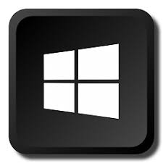
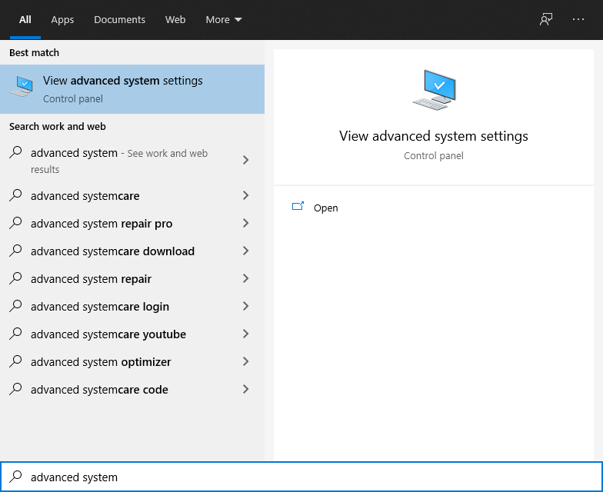
How to deal with errors after installation
Press the Windows button on your keyboard and then immediately type advanced system.
This will bring up a match for View Advanced System Settings
Select this option

Slide 5
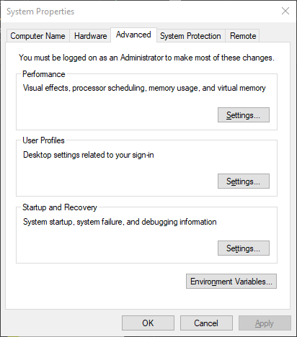
How to deal with errors after installation
The System Properties
dialog box will open.
Select Environment
Variables

Slide 6
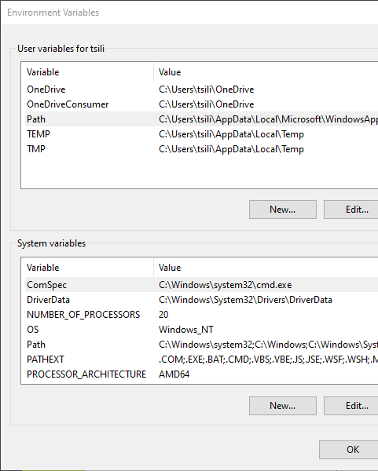
How to deal with errors after installation (continued)
The Environment
Variables dialog box will open.
Double click the Path
User Variable

Slide 7
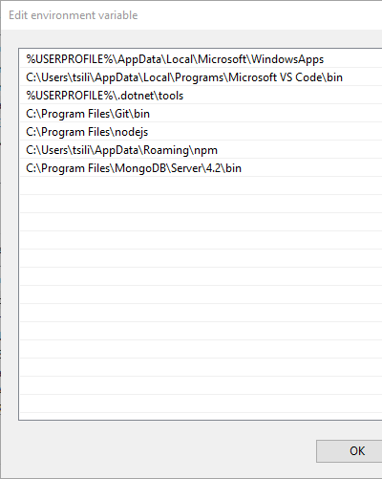
How to deal with errors after installation (continued)
The Edit environment
variable dialog box will
open.
Ensure t hat you have
git, nodeJS, npm and
MongoDB listed here.
If not, find the appropriate
paths on your system and
paste them here in
roughly the same order.
Ensure these are here

